Slide 1
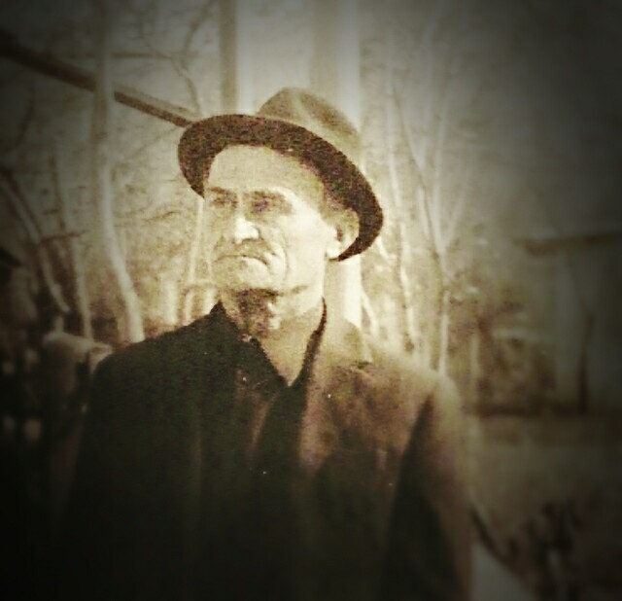
But Ivan Nikitovich

Slide 2
Zelentsova Alexandra
7 B form
School № 16
My teacher: Nekhorosheva
Natalija Vladimirovna

Slide 3
My great-grandfather
I will tell you about my great-grandfather – my grandmother’s dad. His name was But Ivan Nikitovich. He was born on the 2nd of August in 1913. He was drafted to war, when he had been
28 years old.

Slide 4
My great-grandfather
When the war had started, my great-grandfather was severely wounded. He had been in hospital for 8 months, and then he wasn’t allowed to continue to fight, so he was sent to home. But my great-grandfather went to work in coal mines. He was the worker of rear.

Slide 5
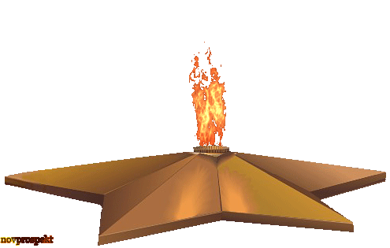
My great-grandfather
He mined coal to our soldiers and the people couldn’t cold and our locomotives could safely ride.
My great-grandfather died in 2004 when he was 91 years old.

